Slide 1
First Amendment Freedoms
Find a slide
Create a slide for the first amendment freedom of your choice. See a sample on the next slide.
When you are done, leave a comment on a classmates slide!

Slide 2

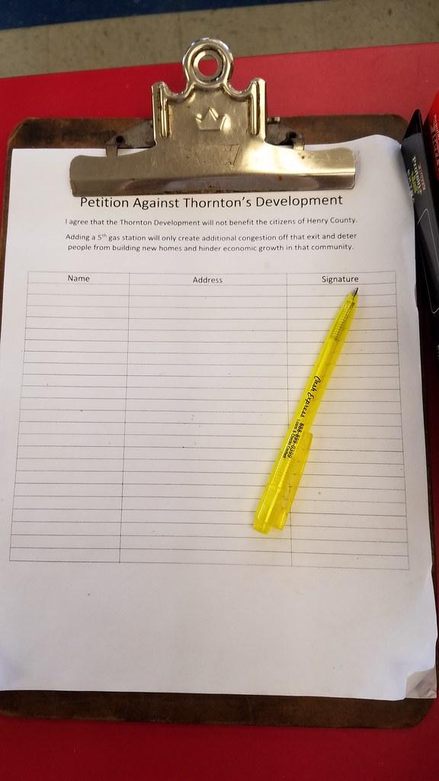
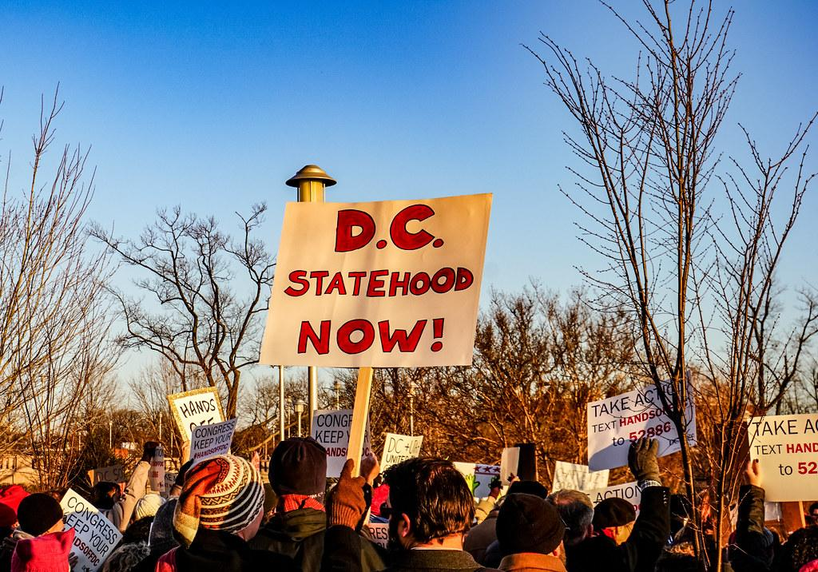
PETITION
Freedom to petition the government: Communicate with the government and make a request for a change. Can come in many forms.

